Slide 1


YETI Coolers Salesforce Intro Training
The purpose of this training is to get each inside and outside rep used to the CRM and order management functions of Salesforce in preparation for deeper training in January

Slide 2
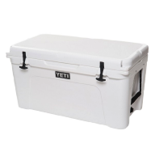

One View of the B2B Customer
Leads
Marketing
Contacts
SalesForce houses all of your data and streamlines your workflow. It simplifies your life and helps you focus.
Accounts
Forecasts
Orders
Opportunities

Slide 3
One View of the B2B Customer
SalesForce layers on top of Epicor to handle all your transactions.
Manage communications and workflow
Emails, Tasks, Cases, Opportunities – Orders
Reporting, Dashboards, Forecasting
Underneath the Scenes
Order Management
Inventory Availability

Slide 4
What’s Changing?
SalesForce is design to help you stay focused on the fun part of your job – selling! We are setting it up to eliminate as much “busy work” as possible for you.
Old World | New World
Place Orders via Excel spreadsheet, then the Inside Sales team re-enters them in Epicor | Place orders directly through SalesForce
Create weekly reports and forecasts | Automated weekly reports and streamlined forecasting
Send emails to customers via Gmail | Send them via SalesForce
Track tasks and reminders on your own | Enter tasks in SF and SF will generate some tasks for you!
Manage calendars and events in Gmail | Manage them in SF
Manage the workflow of onboarding a client | Automates the onboarding process
Request reports for purchase history and invoices | Run the report directly in SF instantly

Slide 5
Create a Lead - Sales
Purpose: A Lead is a way to capture potential customers. Leads can range from a simple thought like: "I should call on that sporting goods store that's in my territory." You could simply create a lead with the name and address of the store. Or, you can have a Lead that has a contact name. You will find leads yourself, and also be assigned Leads. This is how you will document your funnel of potential business. A lead will help you stay organized and track new prospects.

Slide 6
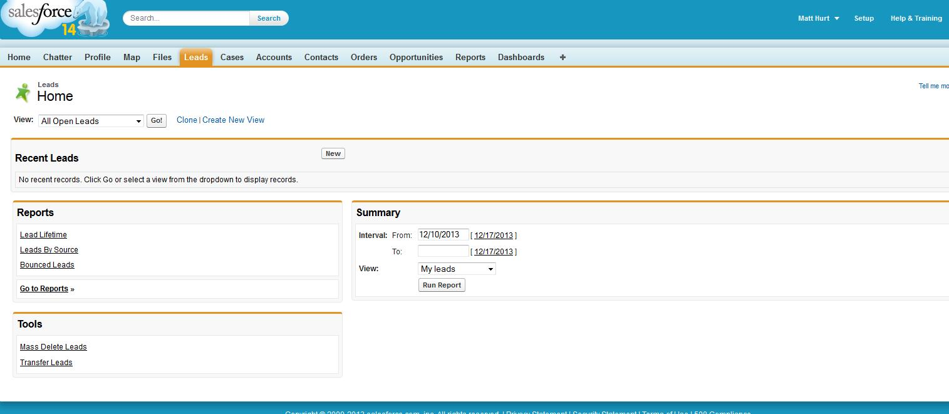
Create a Lead - Sales
Click on Leads tab then “new” to create a new lead

Slide 7
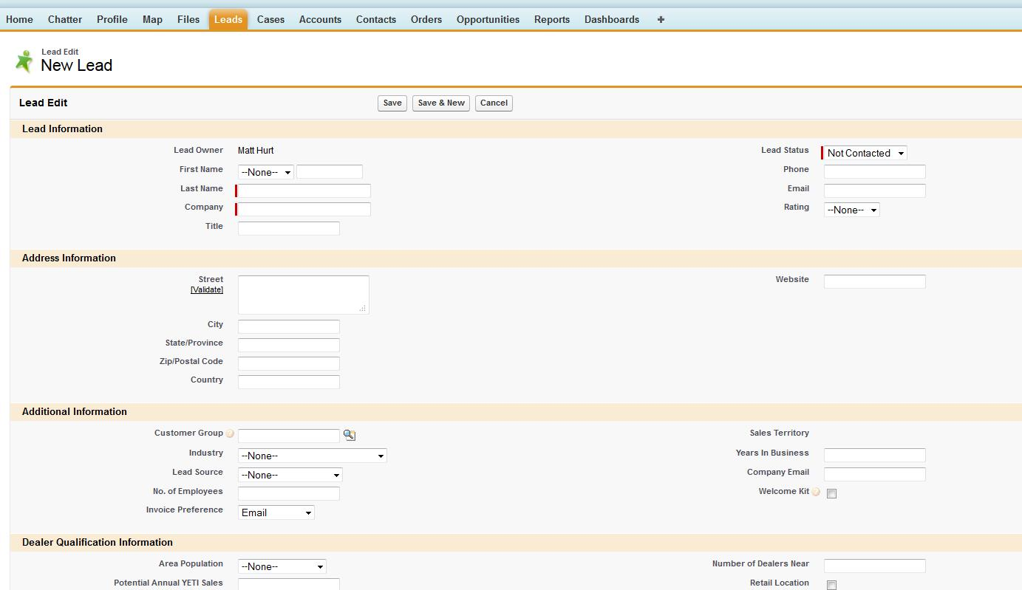
Create a Lead - Sales
Required Fields Summary: Last Name, Company, Industry and Lead Status. The intent is that you can quickly capture leads, even if they are just a prospect that you haven't interacted with. Important, you will need a lot more information before you and your manager turn this Lead into an Account and a Contact.

Slide 8
Create a Lead - Sales
Lead Information: Enter everything you can about the lead. As much as possible. Some of these fields will be required when you convert to an account anyway.

Slide 9
Create a Lead - Sales
Address Information: This is the business address where the lead resides. The “validate” link below Street will validate the address and verify its existence. You can use this as a shipping address later as well. If it is a PO Box, you still need to validate it.

Slide 10
Create a Lead - Sales
The Customer Group is what determines pricing. Company email will be a good future contact. Both these fields will be required before converting to an account so we recommend you update these as early as possible.

Slide 11
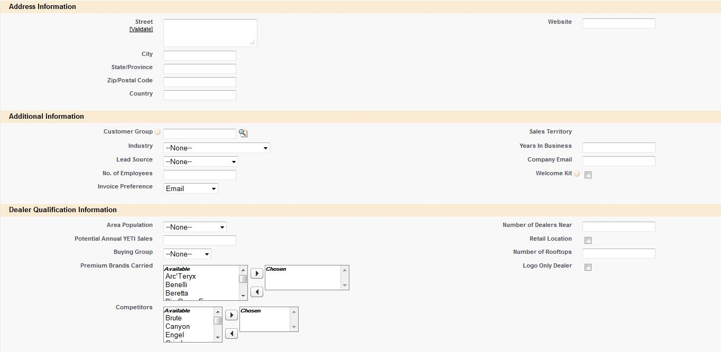
Create a Lead - Sales
Dealer Qualification Information: None of these are required, but you should do your best to get this information gathered so you and your manager can make an informed decision about whether or not this organization should become a YETI dealer.

Slide 12
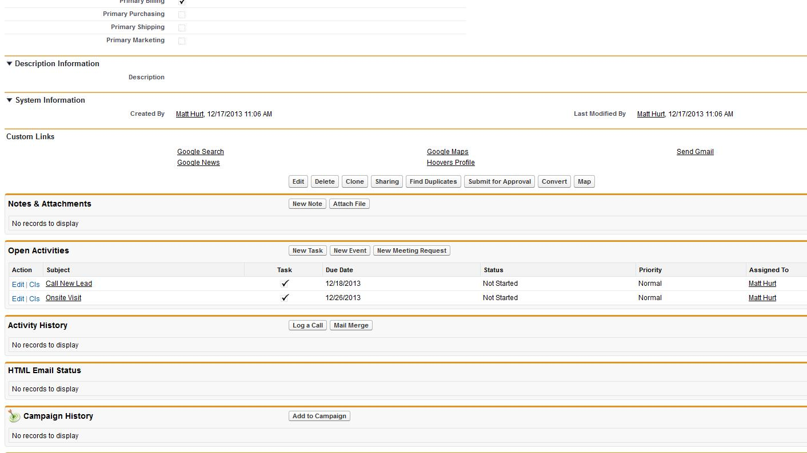
Create a Lead - Sales
Save: creates the lead for you and gives you a couple of activities right away: 1. Call the lead within 24 hours and visit the lead within 30 days. You can update these based on the situation once they are created.

Slide 13
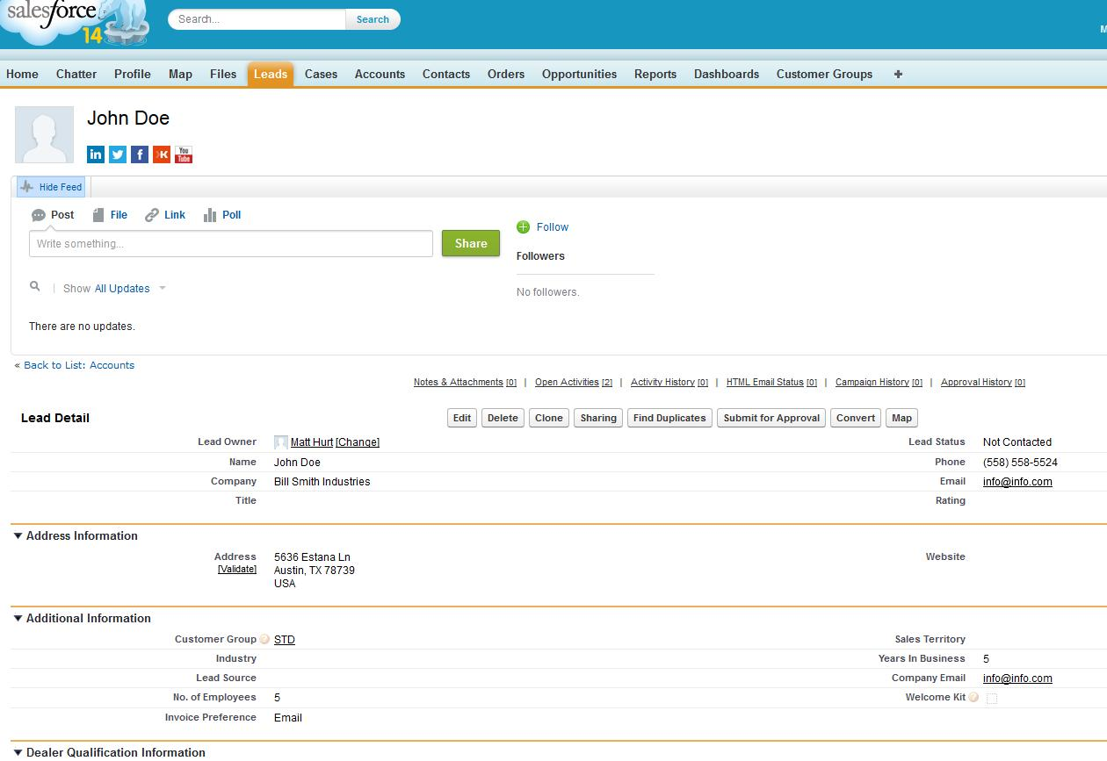
Create a Lead - Sales
Submit for Approval: Before you can submit for approval, there are some required fields: Name, Company, Phone, email, company email, address information, Customer Group. Once you finished entering all the information your next step is to submit the lead to your Manager for approval. To do this, click on Submit for Approval.

Slide 14
Approve a Lead - Manager
Purpose: In order to pursue a lead beyond the courting stage, you will need to create an Account. The only way to start this process is to have your Manager approve the Lead. This is an important step and it compels you to partner with your Manager to make sure the potential dealer fits all the criteria for YETI and will maximize your sales
Your Manager will see a notice on his/her Home page feed saying that one of your team members has submitted a lead. He/she will also receive an email notification. The Manager can approve the Lead right away from the Feed. IMPORTANT: Approving a Lead begins the process of creating an Account. So, we recommend your Manager should review the Lead information first and, if necessary, discuss it with your Sales Rep. To do the Manager will click on the link in his/her Feed, or from his/her email and review the lead. To Approve or Reject the Lead, scroll down to the bottom of the interface and click Approve/Reject

Slide 15
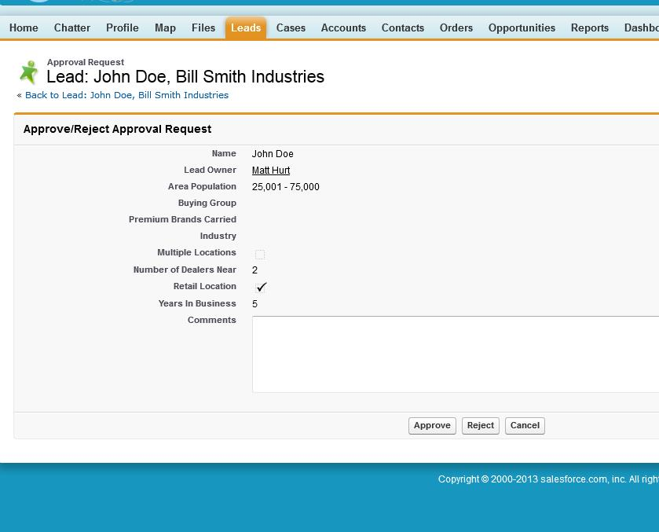
Approve a Lead - Manager
Approve/Reject Approval Request: You will now see the Lead summarized for you. Assuming you are approving the lead you can make some positive comments or suggestions in the Comments sections. In the case where you are not approving the lead, you could write what you need to see in order to give approval, or that this Dealer will not fit the profile and should not be submitted again. Once you submit, you will see what you did in the Feed of the Lead. You can always scroll to the bottom and see the actions and notes that you wrote regarding the approval.

Slide 16
Converting a Lead - Sales
Purpose: You need to complete this step in order to finish the new account conversion. At this point, it is not official yet. In fact, you may convert several Leads that ultimately will not become Dealers. This conversion helps you kick off taking your Lead to the next level in the process.

Slide 17
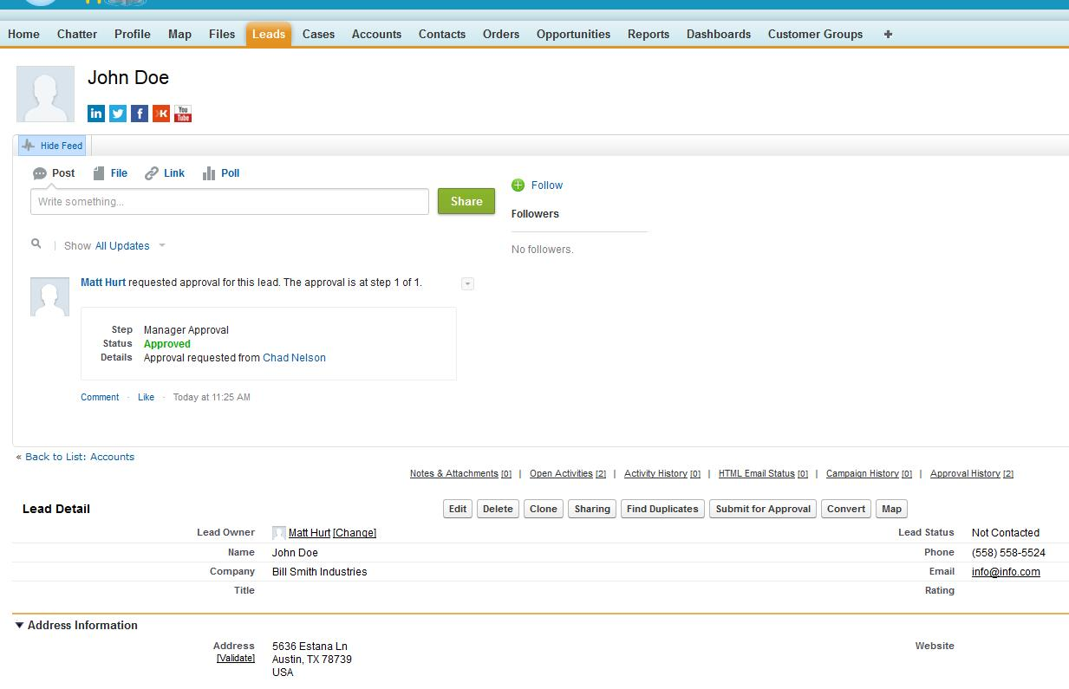
Converting a Lead - Sales
1. You can get to this Lead under the Leads tab
2. You will also receive a notification in your email and chatter feed that your manager has approved the lead

Slide 18
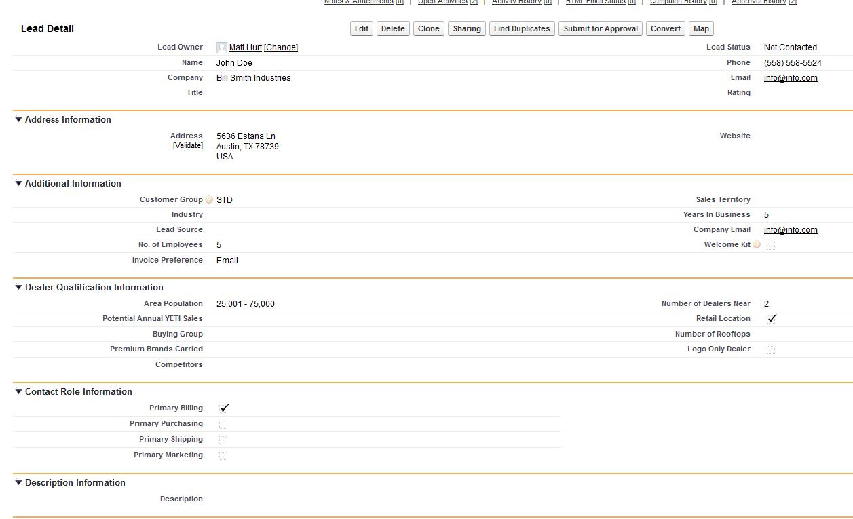
Converting a Lead - Sales
Once the account is approved by your manager you will need to enter a few required fields to convert this lead to an account: Name, Company, Phone, Email, Company email, and Customer Group. Once populated click “Convert”

Slide 19
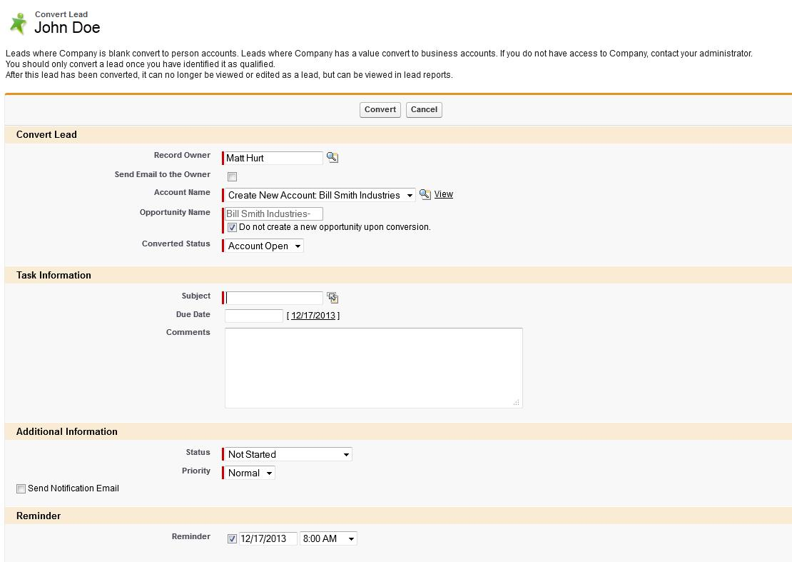
Converting a Lead - Sales
This screen will allow you to verify key account info
You have the option of creating a Task if you wish. This can save you some time because you can create a follow-up reminder at the time of conversion, vs. having to go back in and create a Task later

Slide 20
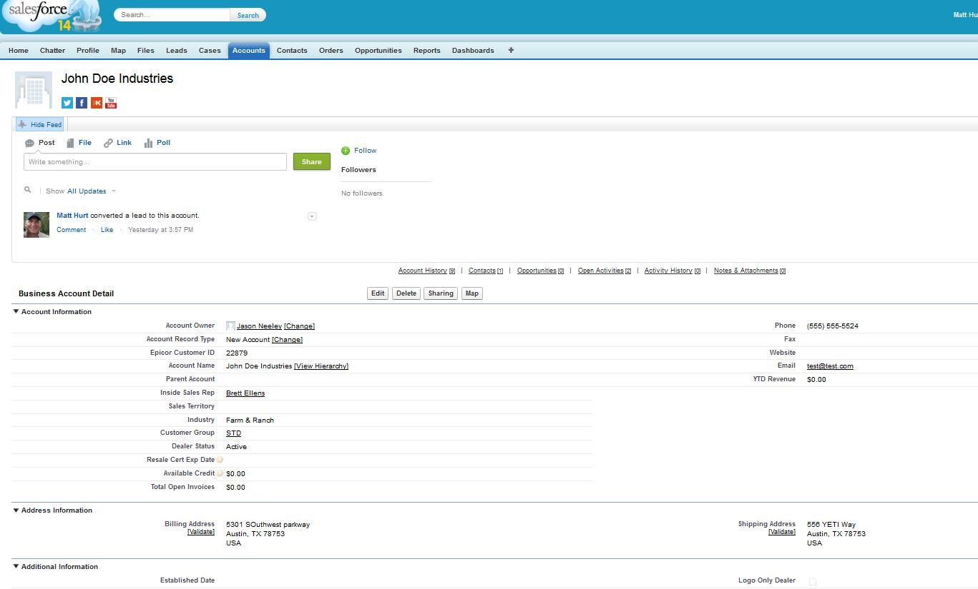
Converting a Lead - Sales
Once you click Convert you will automatically be taken into your new Account. Notice that the feed will say that you converted it.

Slide 21
Account Finalization - Sales
Purpose: This is the point where you will be entering all the important information needed to make this Lead a potential dealer. Important, there will be times that you will create an account but it doesn't result in business. Maybe they won't sign agreements, or pass a credit check, etc. The only way to discover this is through the conversion process where these events are kicked off.

Slide 22
Account Finalization – Sales
NOTE: The conversion button you pressed earlier did a few things automatically for you: 1. It Created an Account, 2. It Created a Contact. 3. It started the process of creating an account in Epicor. You will need to complete more information and tasks to help them become a Dealer.

Slide 23
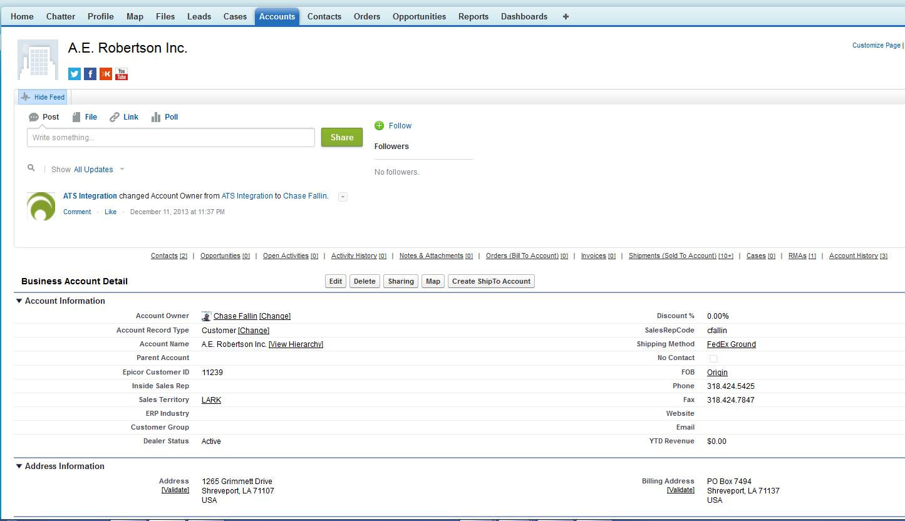
Account Finalization - Sales
Under Business Account Detail section, review the information. This example covers a single dealer model so you won't have to address Parent Accounts. The Sales Territory will automatically be populated once it syncs with Epicor, so you don't have to worry about that. What you do want to do is edit any information you can here. To start this process you click on the Edit button.

Slide 24
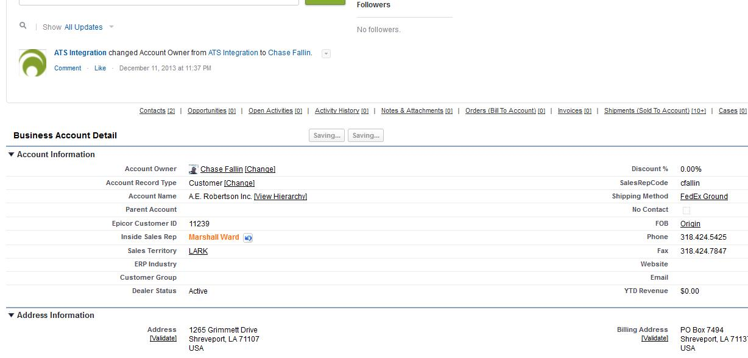
Account Finalization - Sales
Under Account Information: If you know who the Inside Sales Rep is who is partnering with you on this Account you can select him/her by clicking on the "magnifying glass" icon next to the Inside Sales Rep field and finding your Inside Sales Rep. If you don't, leave it blank.

Slide 25
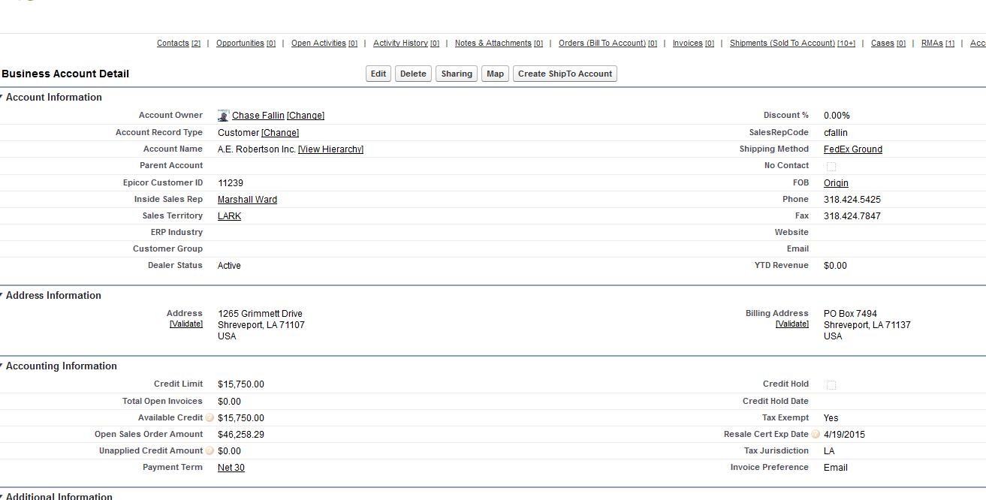
Account Finalization – Sales
Under Address Information: You will need to validate the Billing and Shipping address. Make sure all the information is filled in to the best of your knowledge and click Validate under the Billing Street, and then under the Shipping Street. This searches for shippable and mail-able addresses. It also works with PO boxes too. This is an IMPORTANT step to help save potential errors down the road.

Slide 26
Account Finalization - Sales
The Accounting Information field will give you all key accounting information. You will not be able to edit these fields, but you will have insight into the customer account status

Slide 27
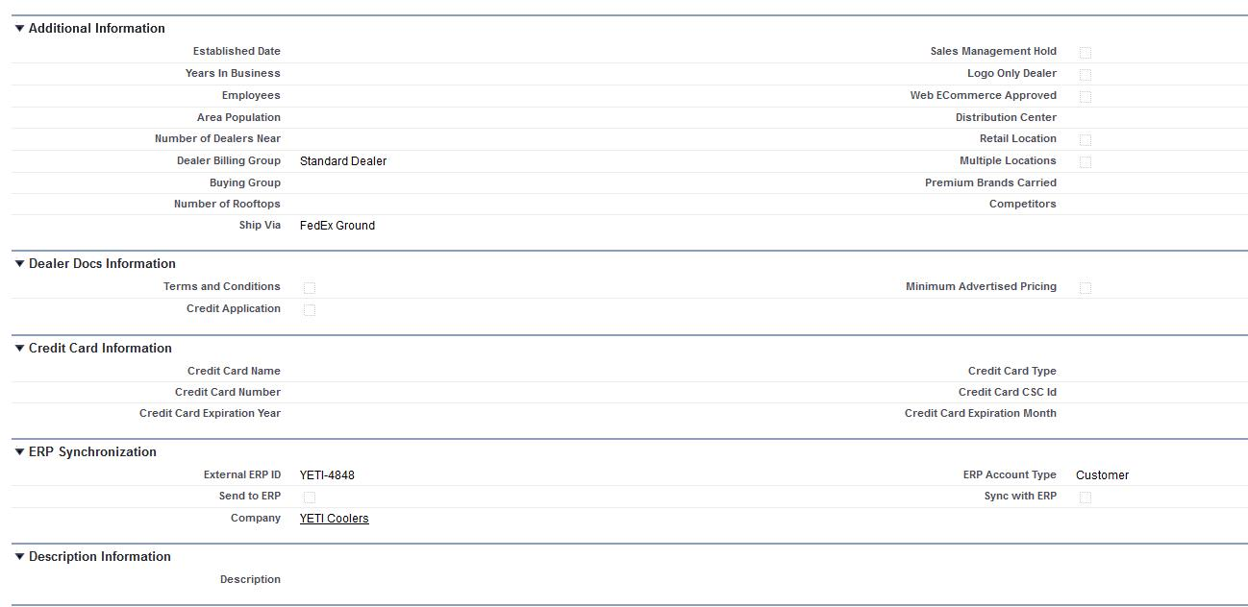
Account Finalization – Sales
Under Additional Information: Years in Business, Employees, Number of Dealers Near, Area Population, Retail Location, Multiple Locations, Number of Rooftops, Premium Brands Carried, Competitors, etc helps you determine potential volume and mix of product

Slide 28
Account Finalization - Sales
Under Dealer Docs Information: These are important check boxes that YOU will need to check. They indicate whether or not you have taken action to make sure the potential Dealer has these in place. You won't be able to place an order without confirming that you have Terms and Conditions and Minimum Advertised Pricing with the dealer. Credit card terms are the default, if the Dealer wants other credit terms they will need to submit the Credit Application. You can check this box if this is the case.

Slide 29
Account Finalization - Sales
Under Credit Card Information: ALL information is required to complete an order Under Description information you can make notes about this account as you see fit

Slide 30
Account Finalization - Sales
REMEMBER: Hit the save button when you make any changes!!!!

